Slide 1
ENSE 374, Milestone 4
Space Minds
Anupras Burokas, Ahras Ali, Jack Zhao
Wednesday, Dec. 4

Slide 2
Review the project vision
What is your team’s Golden Circle
We believe that everyone should be educated on space exploration as we believe space is a wide frontier that could be explored even further.
We realize this by using Raspberry PI and Arduino MEGA microcontrollers
The result is a physical console easily interactable with buttons and switches
Review the “deep dive”
We are building a NASA imitation console that educates and inspires young minds about the technological advances of space exploration
There aren’t too many space imitation consoles on the market. The ones that do exist are computer programs that are not very suited for the young users
Our rationale is that this project is a good mix of hardware and software. Our stakeholders would include NASA, CSA, SpaceX, Blue Origin, Education Canada, and Hasbro. Our constraints of budget and part gathering were mitigated by finding good deals on parts.

Slide 3
Teamwork/responsibilities
Ahras → Console construction (woodworking), and hardware construction (soldering, connecting, etc.), and Team Management
Anupras → Documentation (GitHub, presentations, FRD, code reviews, etc.), and hardware construction (wiring, labeling, testing, etc.)
Jack → Arduino and Raspberry PI programming and troubleshooting
Where → Ahras’s house basement
Why → Jack enjoys coding a lot, so he chose to be the lead programmer. Ahras enjoys being a team leader, enjoys woodworking, and challenges. Anupras enjoys writing quality documentation, as well as tinkering with hardware and wires.

Slide 4
MVP 2 demo
We consider this to be a good MVP because:
We got all of our desired functions implemented (+ bonus functions)
We could possibly tinker even more with the wiring setup to clean/simplify it as much as possible
We implemented the missing MVP 1 function, added all the MVP 2 functions, as well as added some bonus functionality since we had extra time left on our hands

Slide 5
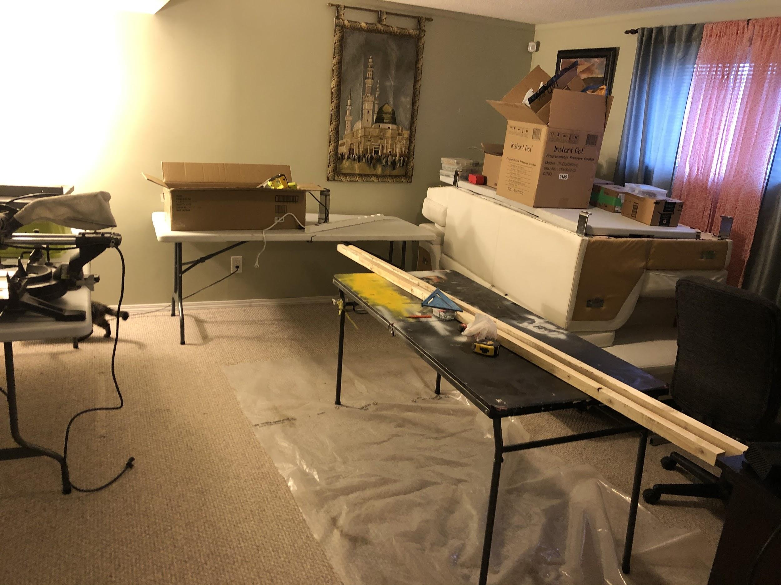
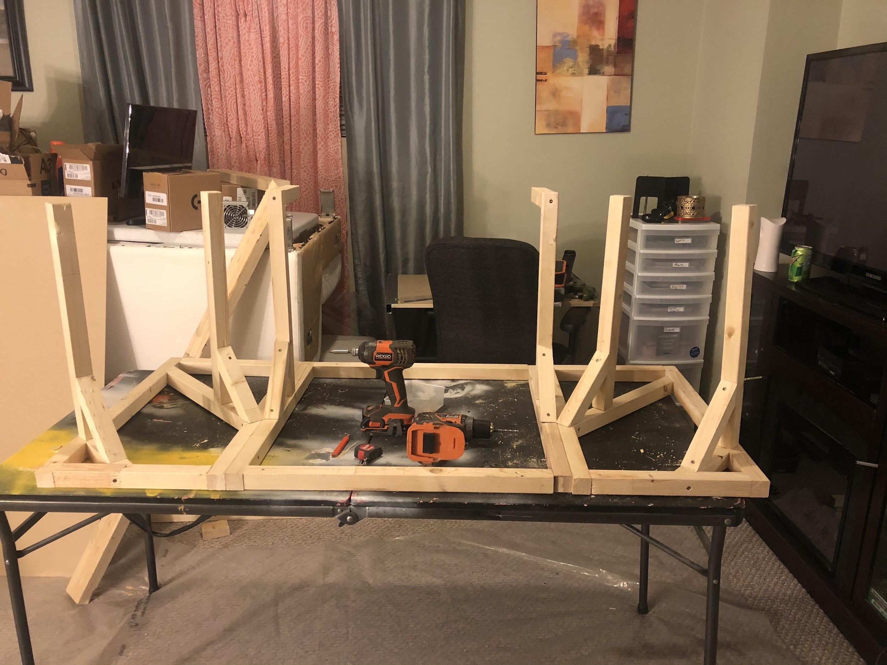
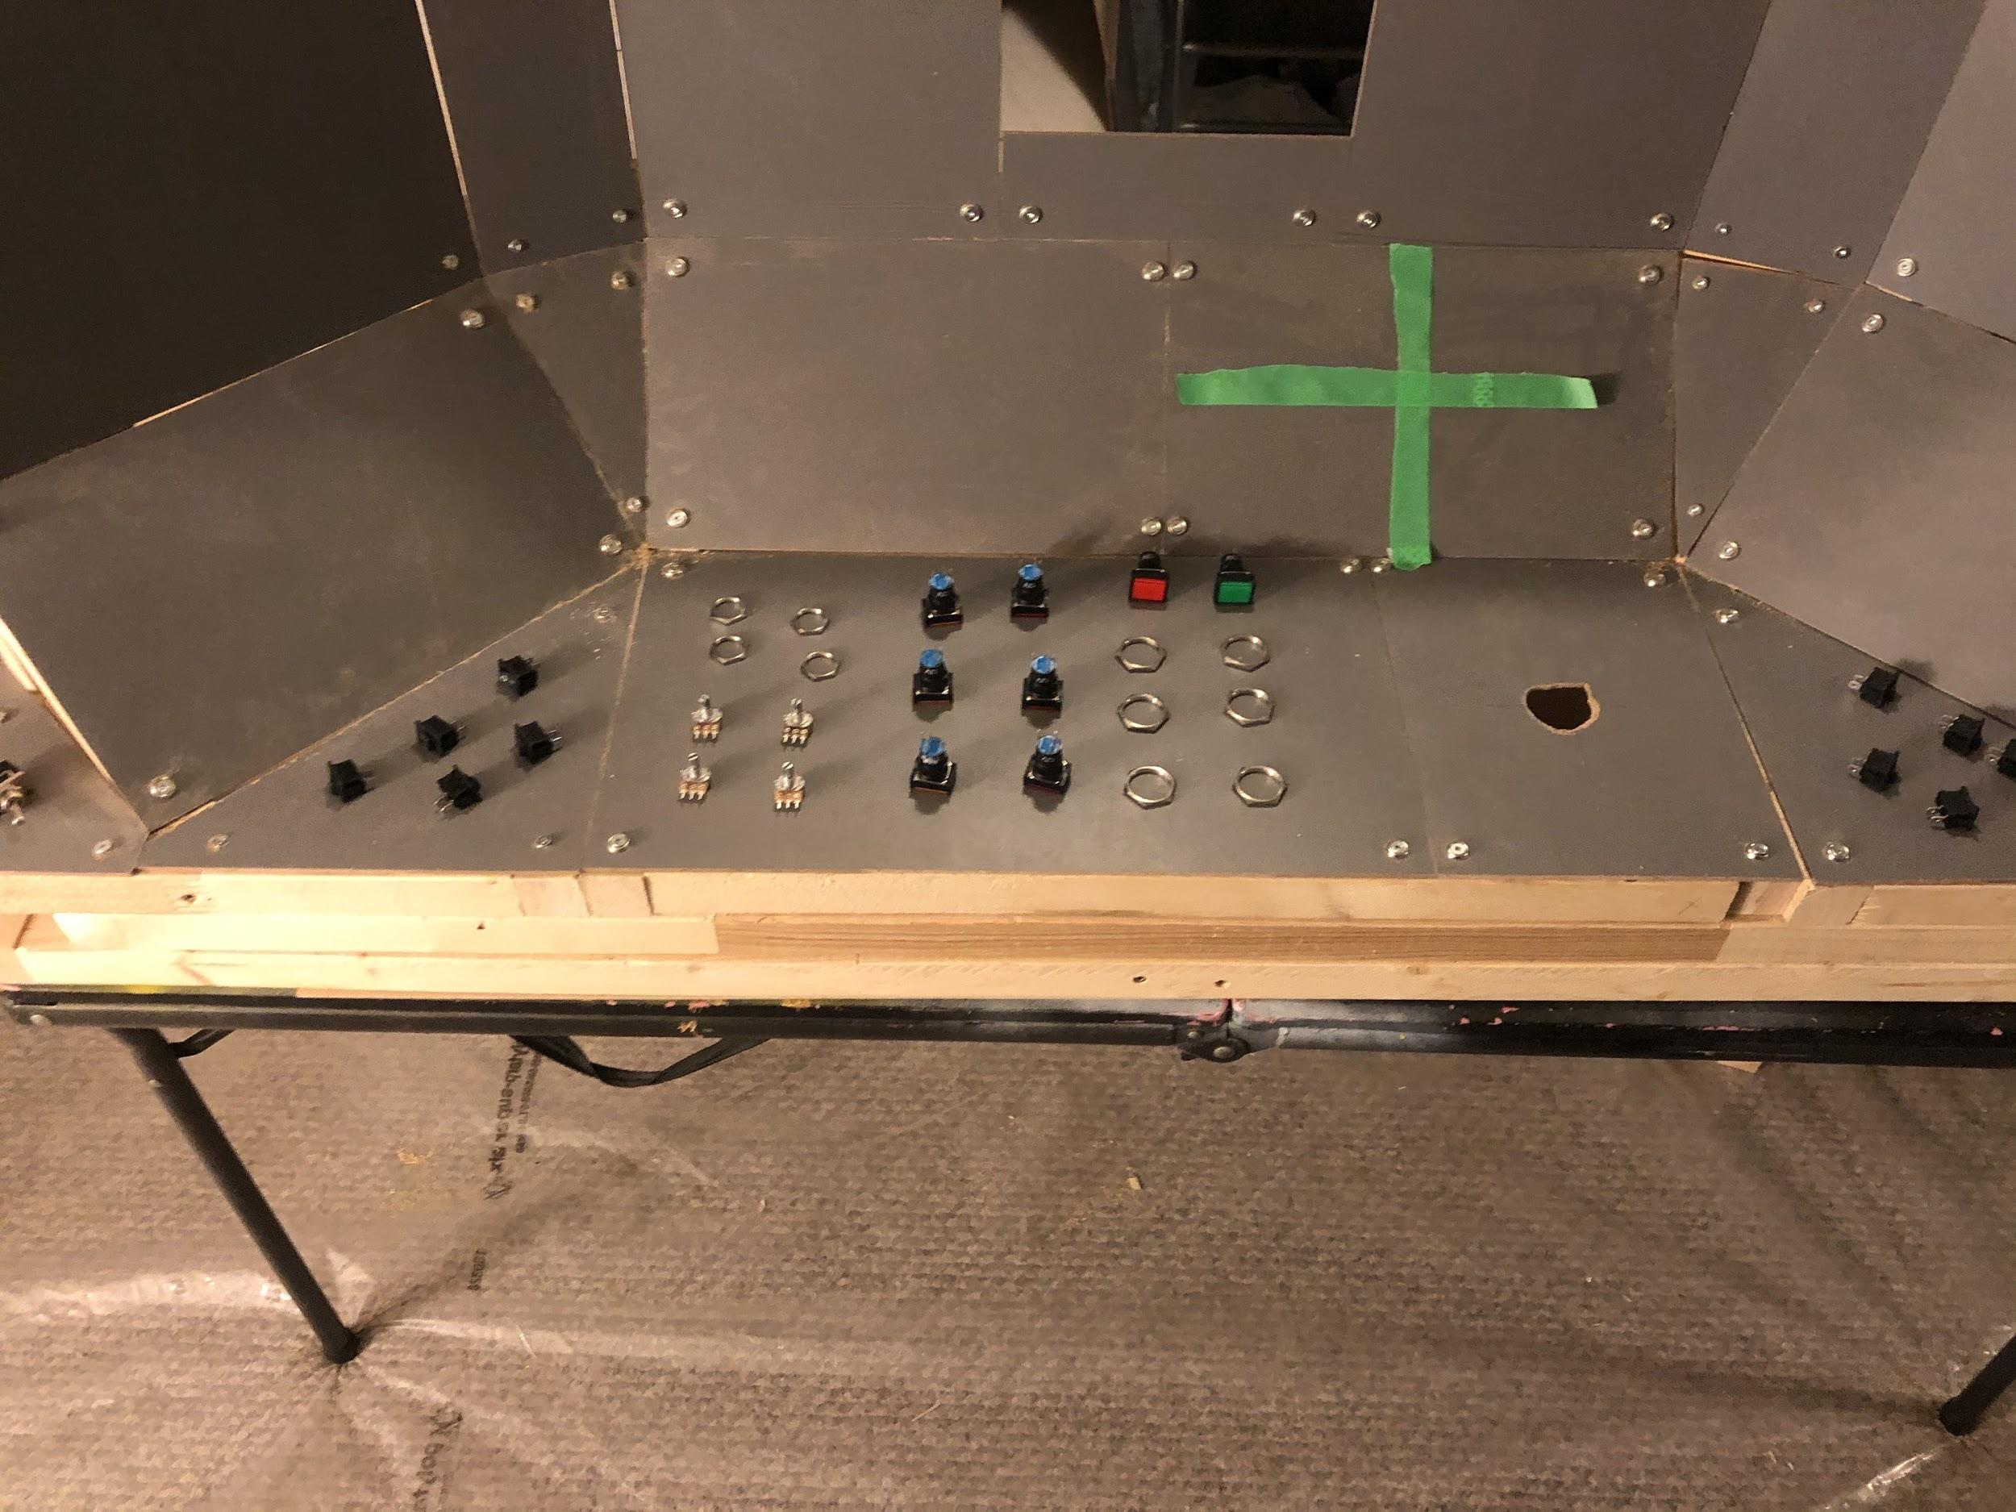
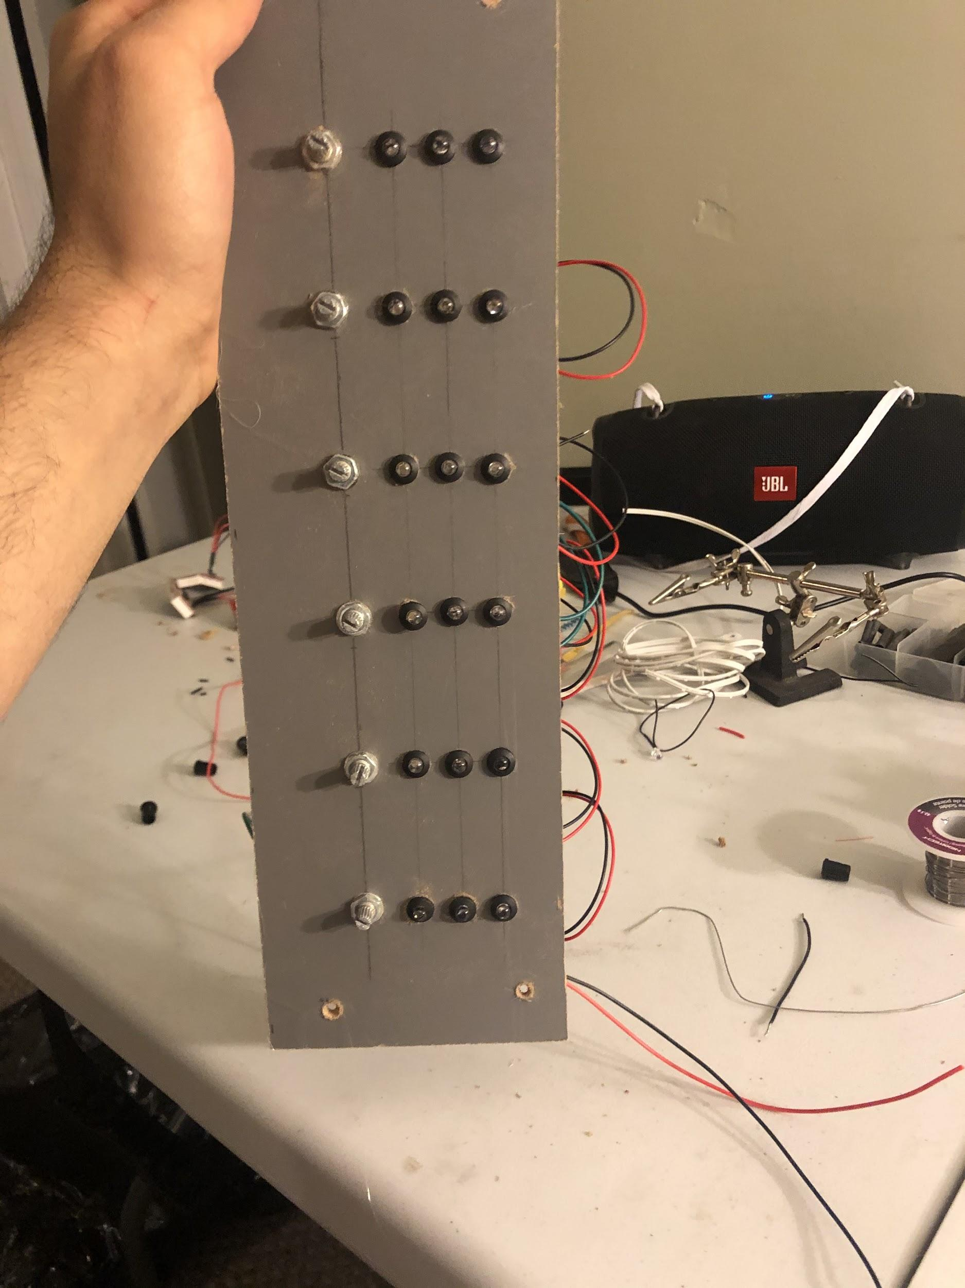
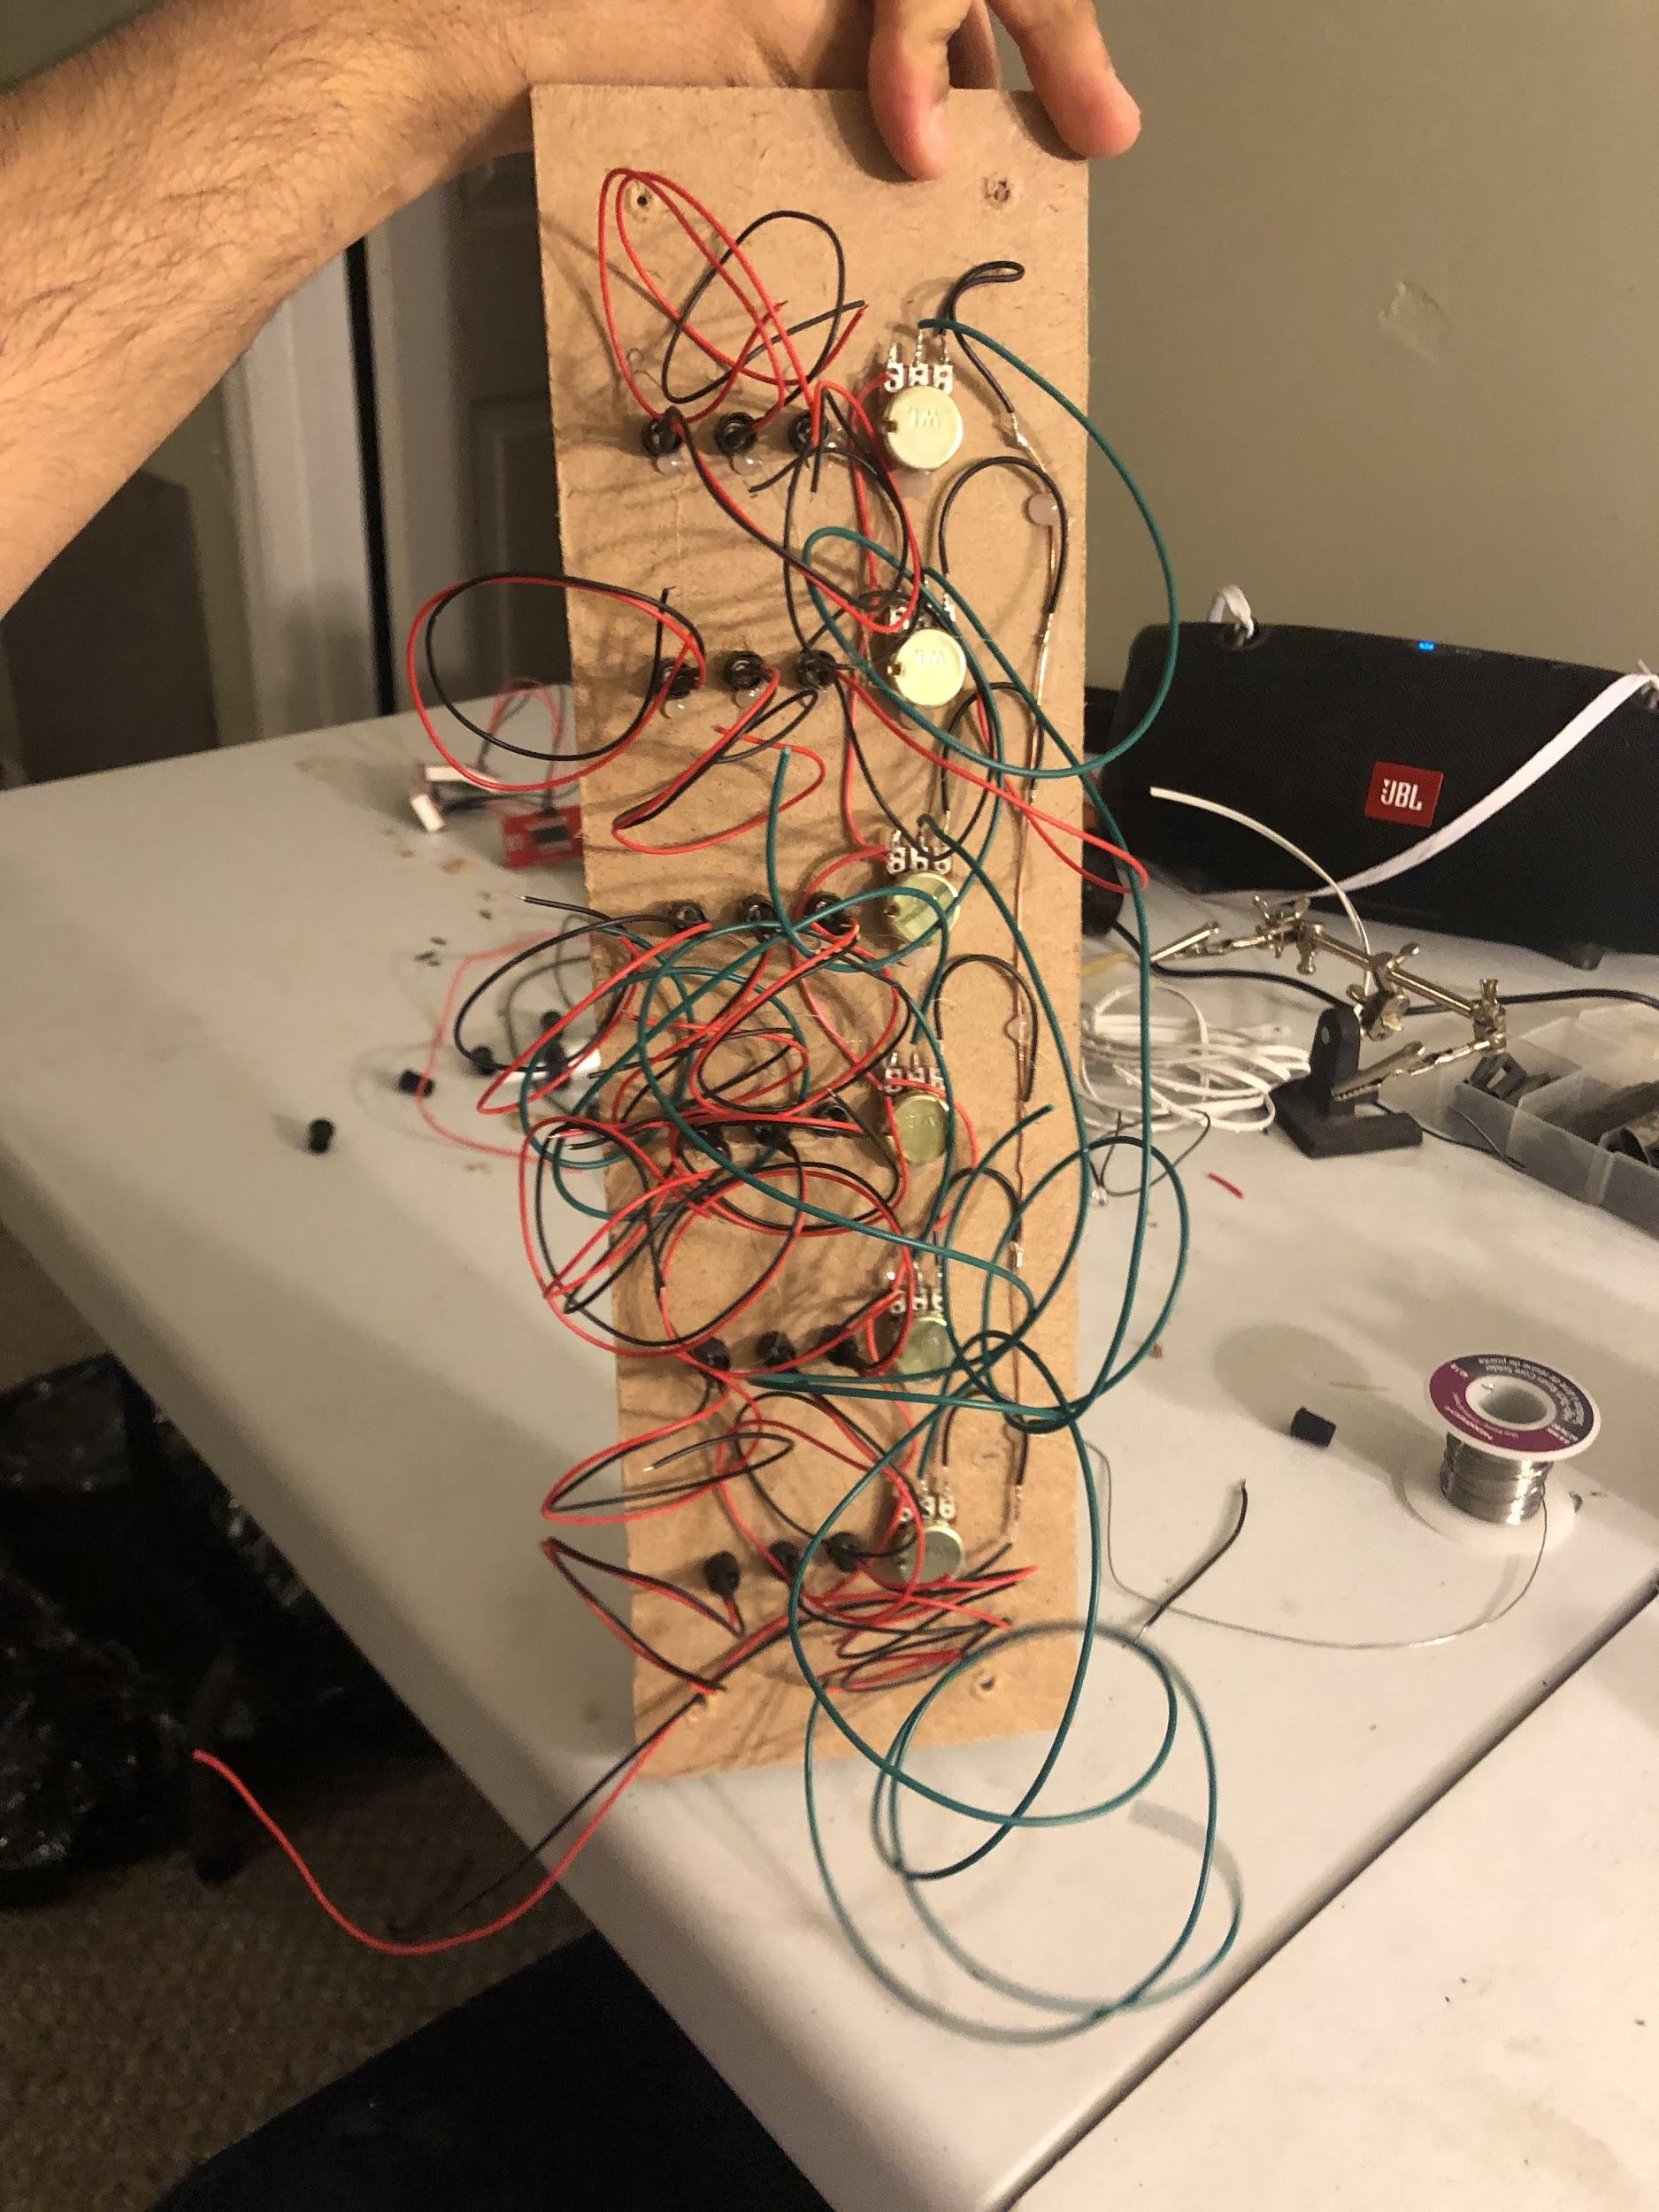
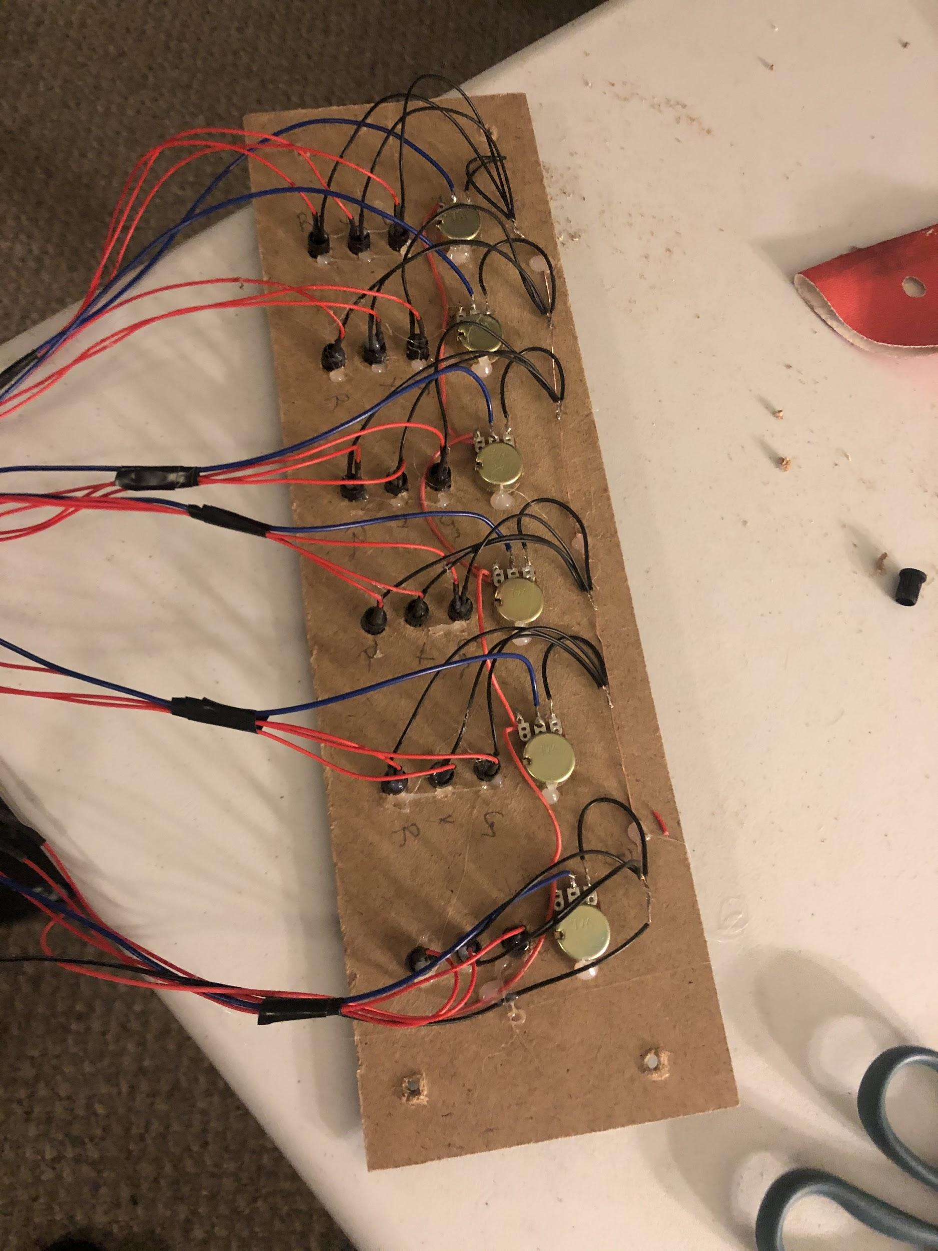

Slide 6
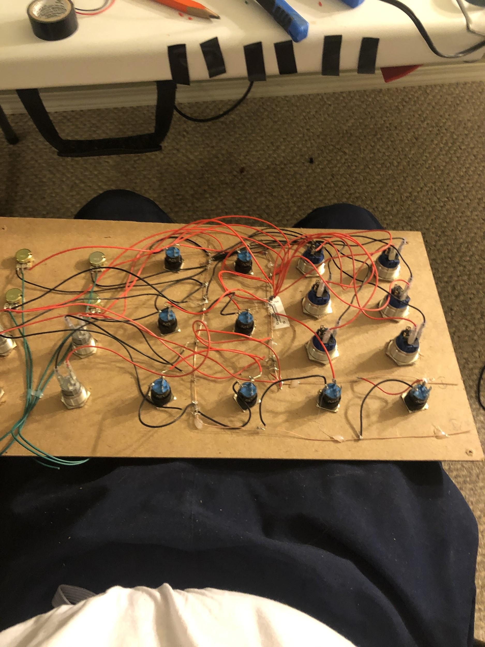
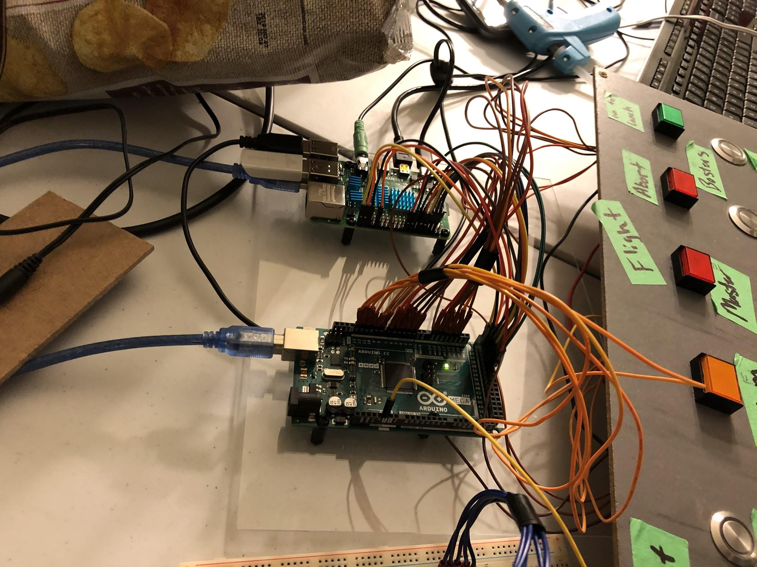
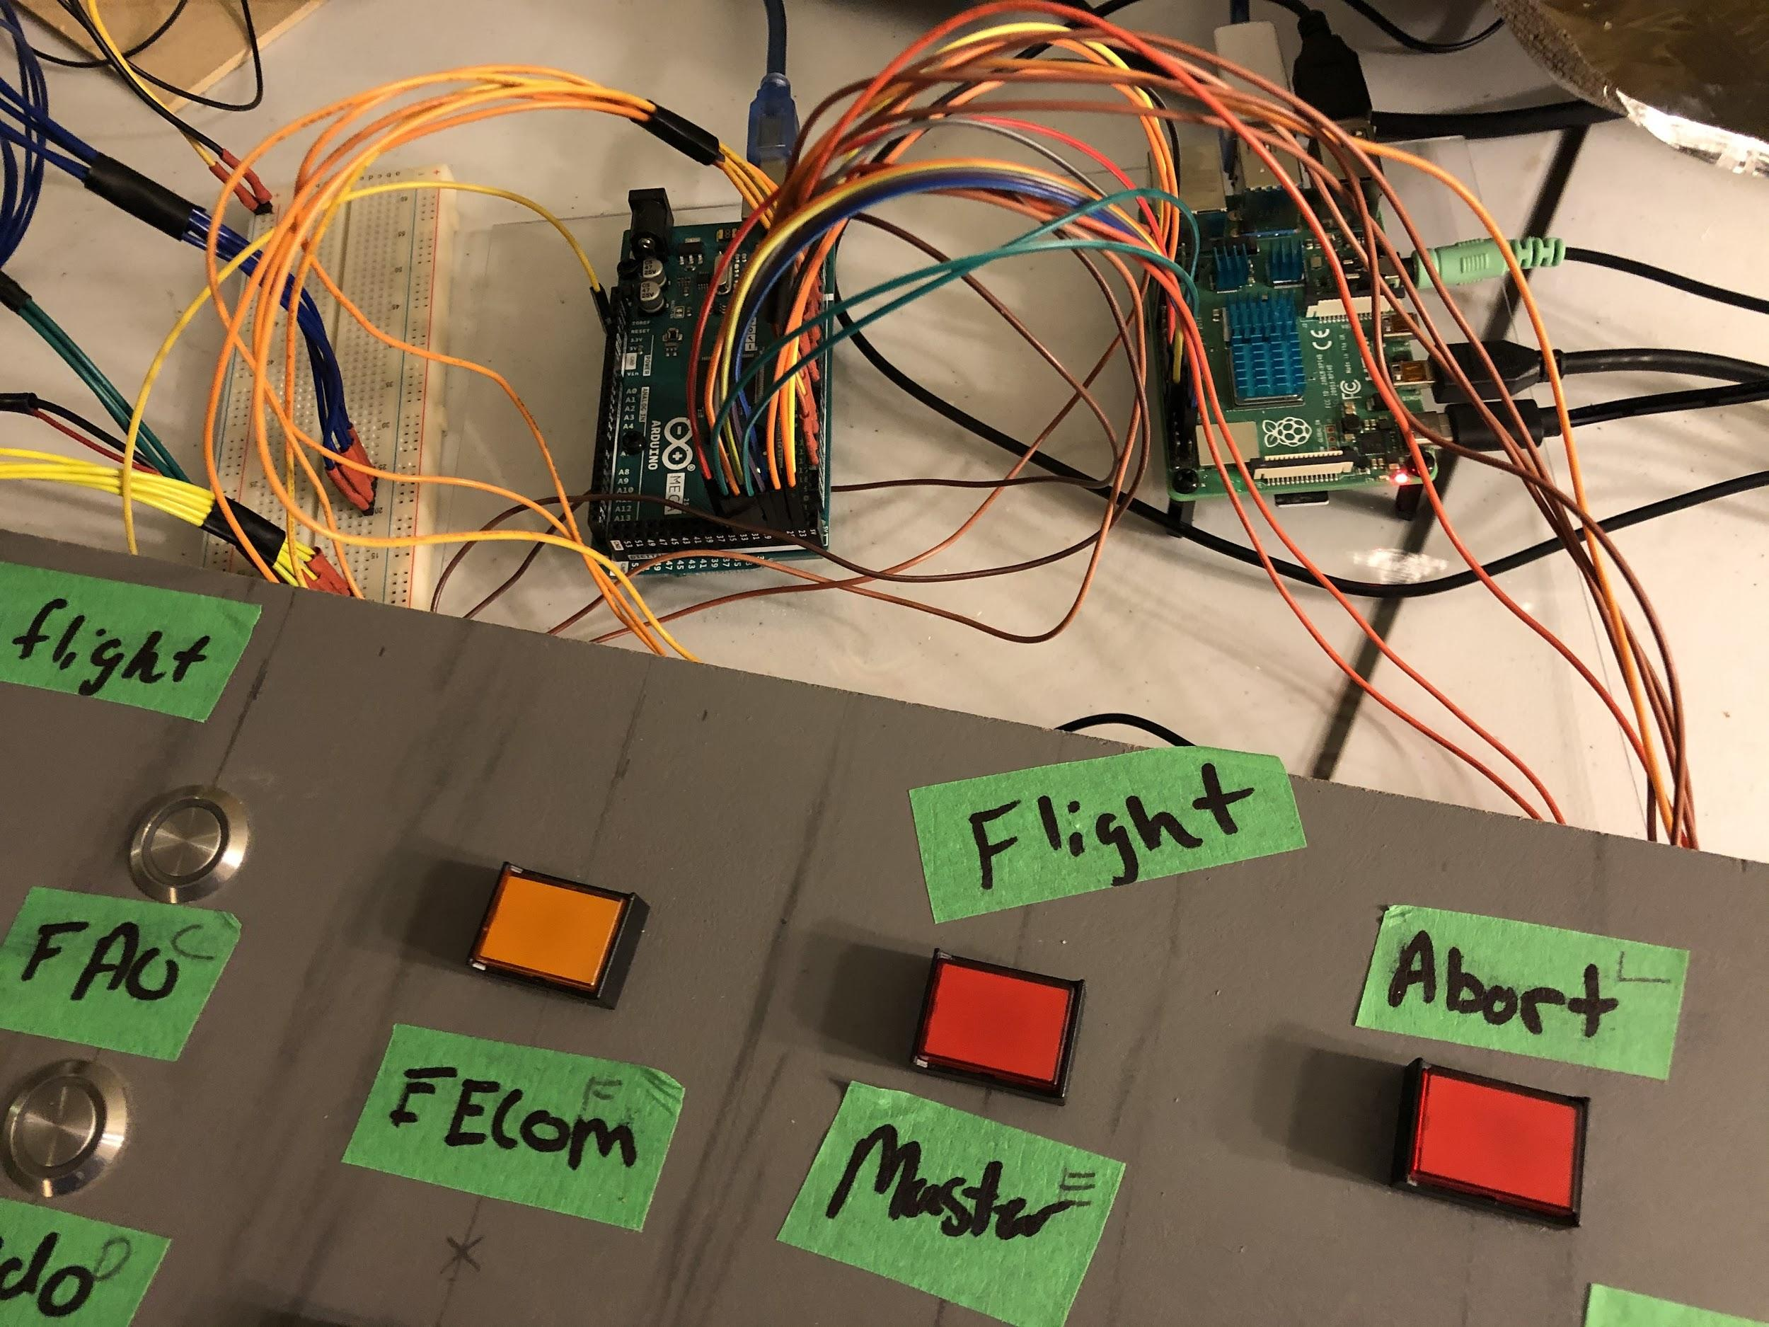

Slide 7
Feelings, future MVPs & GitHub
Feelings
We consider this project to be a great success
Our biggest highlight moment was when our code was bug-free and running after several hours of head-scratching and going nowhere
Expanding the console (along with the functionality) was our only direction change
Our code is very linear and repetitive, so since it was already clean in our MVP 1, we didn’t have to clean it up any further
For a potential MVP 3, we would add servo motors for even more interesting/realistic functions; we would refine our code and wiring even more, and add more stages to our console
Review your team’s GitHub
We have uploaded all of the files (code, audio/video files). We uploaded an “Official Launch Guide” made by us. Everything was moved to the ‘Done’ pane
Since our code is very linear and repetitive, this project could easily be taken on by another team and easily extended without too much time spent learning or understanding.

Slide 8
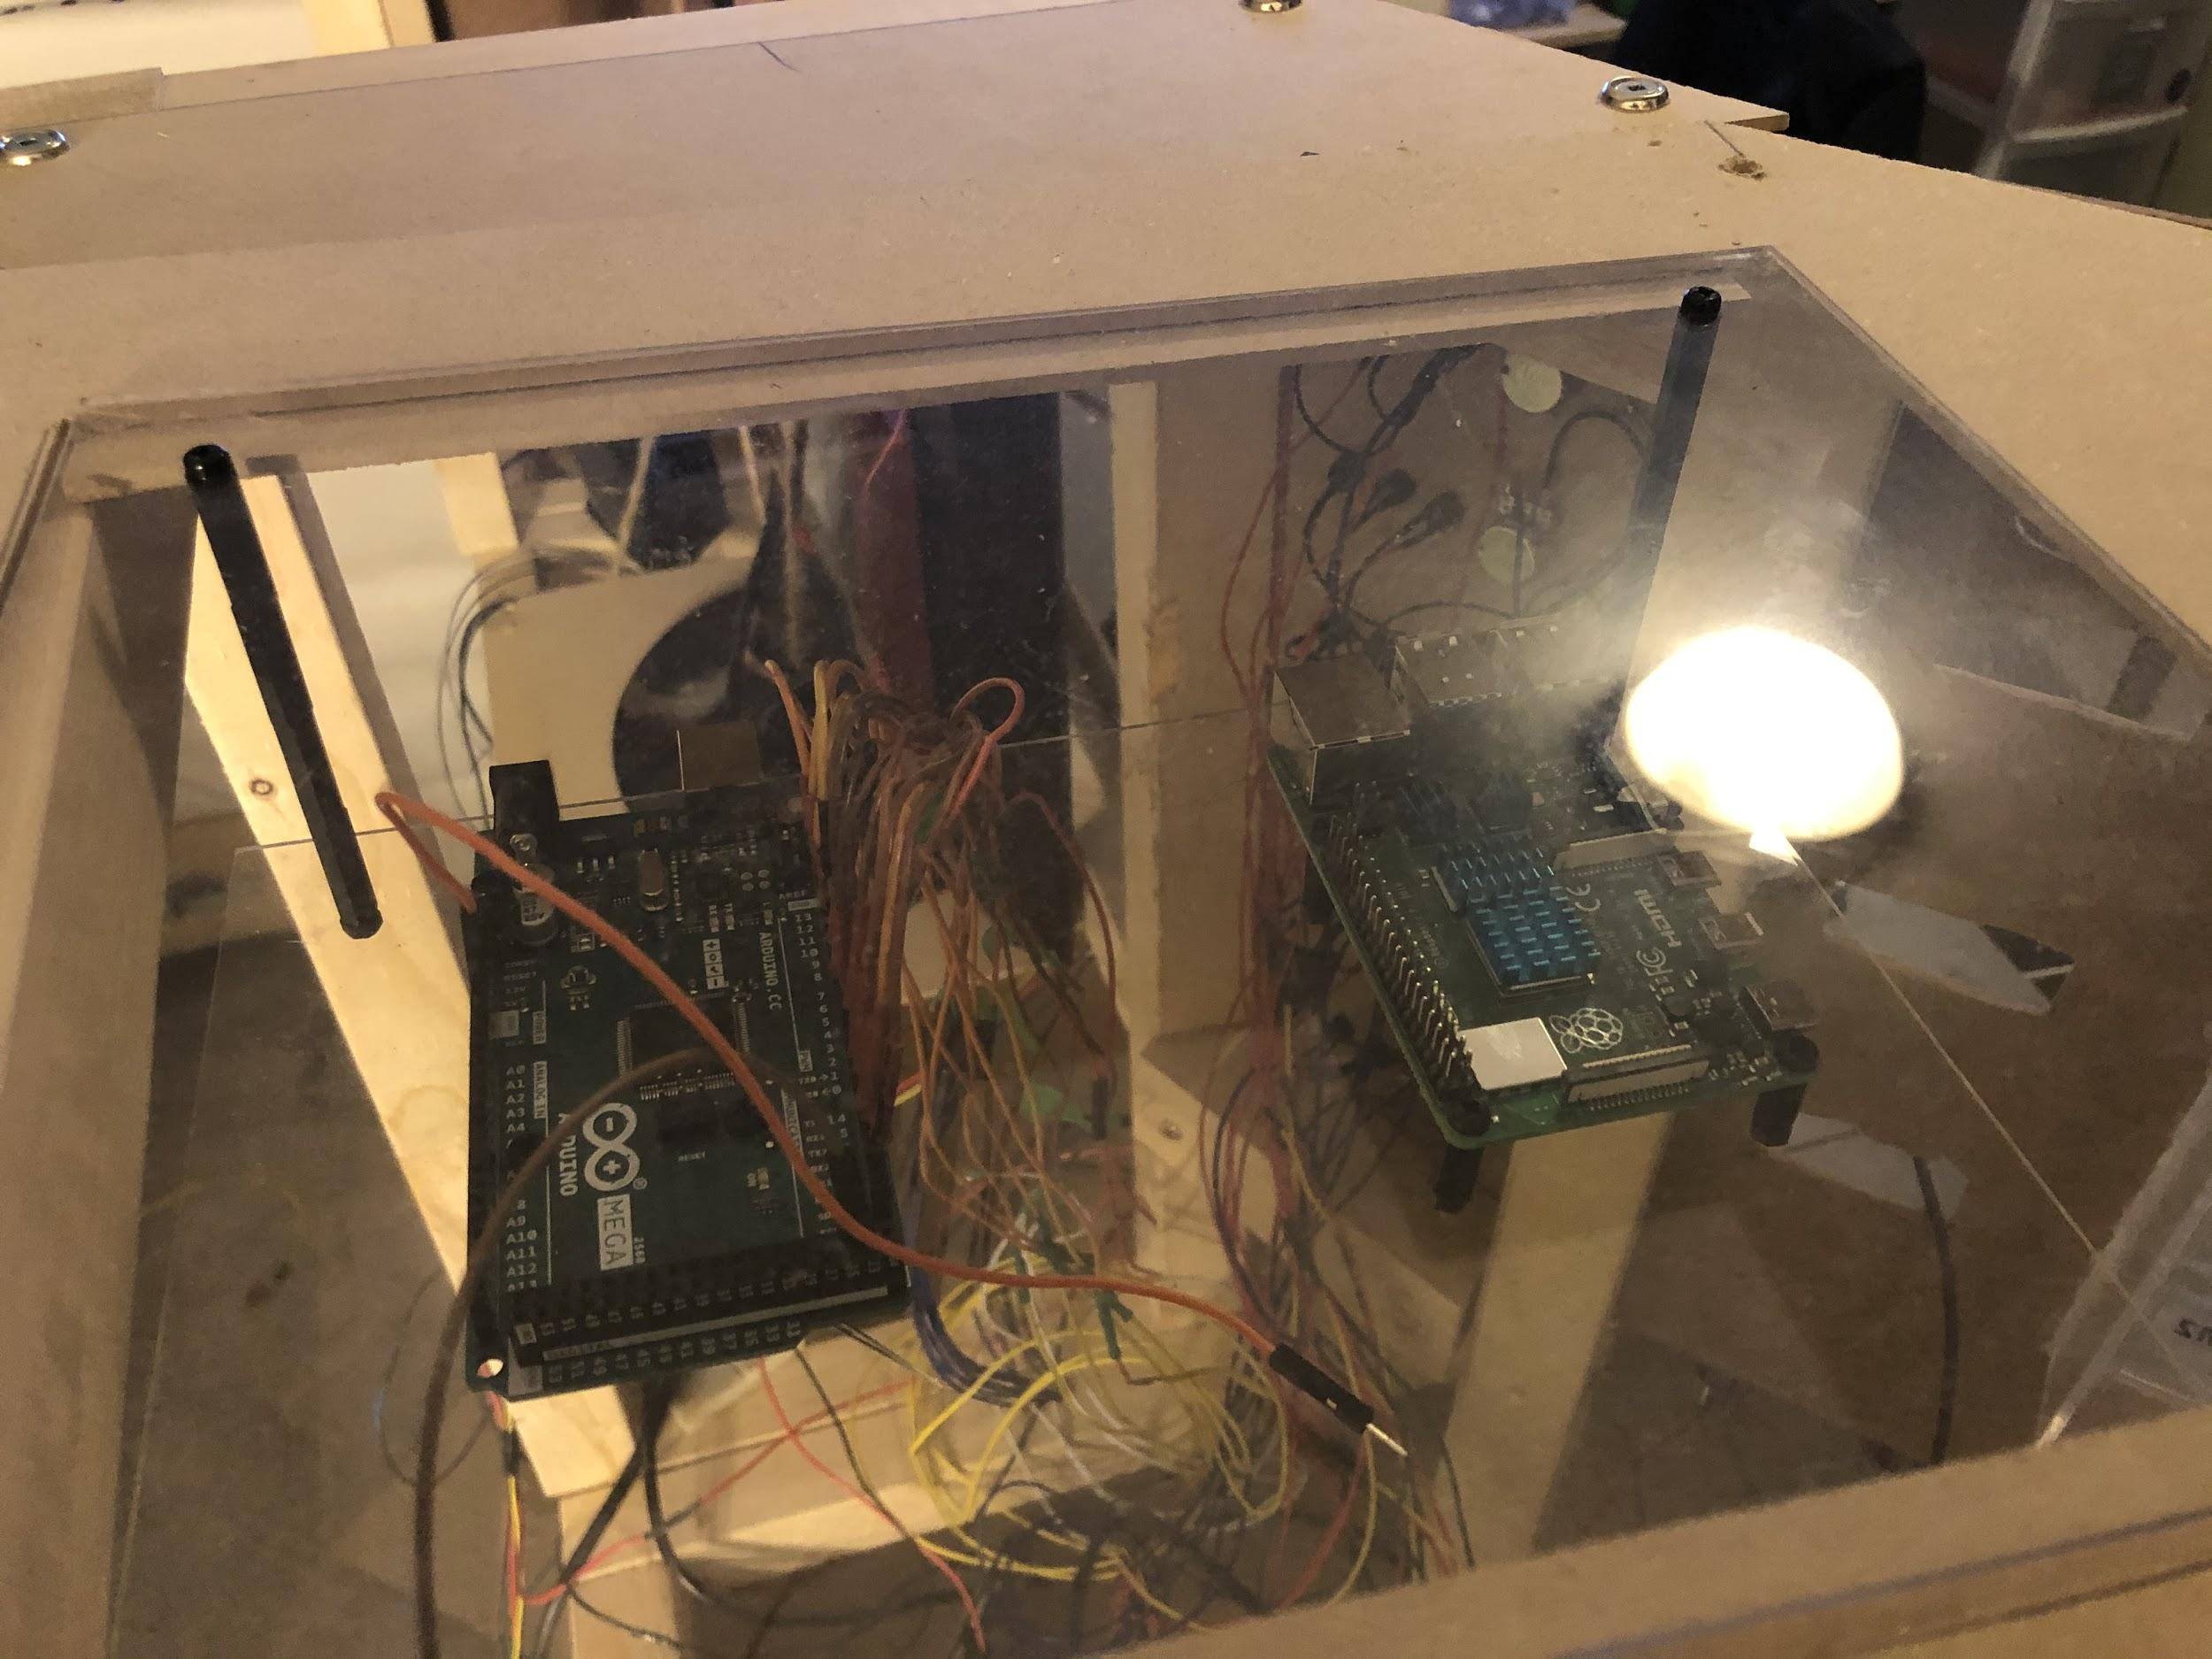
Recap of the MVC architecture
Our model is a Raspberry PI along with an Arduino MEGA. You can see it through a transparent panel at the top

Slide 9
Recap of the MVC cont.
Our view is the monitor, the LED’s, LED buttons, anything that lights up
Our controller(s) are the buttons, the rotating knobs, switches, LED buttons (both a view and a controller), the joystick and the radio

Slide 10
Group reflection
How did you feel about this project? What did you like about it? What did you dislike?
We liked all aspects of this project, from the coding to the building to the documentation. The programming part was the most fun one since this is where we got to see our envisioned functions come to life
What did you learn about yourself as you collaborated and worked through this project?
We learned that each of us are good at something, and that delegating tasks will lead to the most work done in the quickest time possible
How will you use what you have learned going forward?
The most important thing that we learned is good team management skills, which will be very beneficial in our careers. The second most important thing we learned is that good documentation can make or break a project
What “stuff & things” related to this project would you want help with? – Could have been better?
Testing in the real environment

